Slide 1
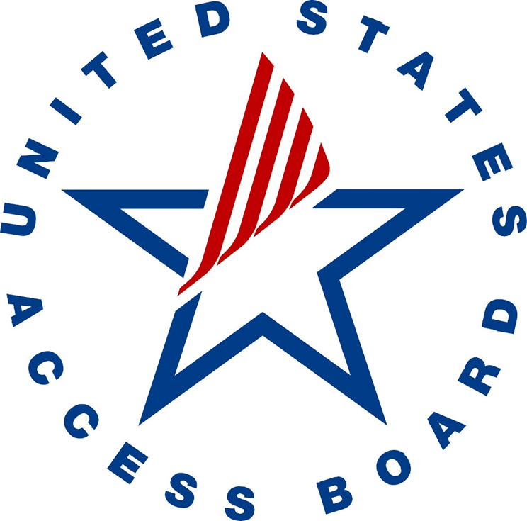
U.S. Access Board

Slide 2
Access Board Training Update
Accessibility Program Managers Meeting
Timothy Creagan, Access Board
Monday, April 8, 2019

Slide 3

Board’s Mission
Board’s Mission
establishes access guidelines & standards
provides technical assistance & training
enforces standards (federal sector)

Slide 4
Training and Technical Assistance
Training – upon request, tailored to audience
Webinar series – CIOC and Section 508 Best Practices
Collaborate on technical assistance materials posted at 508@access-board.gov
Technical assistance Hotline
Voice: (202) 272-0080 or (800) 872-2253
TTY: (202) 272-0082 or (800) 993-2822
Fax: (202) 272-0081
Technical assistance 508 email
508@access-board.gov

Slide 5
CIOC Section 508 Best Practices Webinar series 2013 - present
Collaboration between Access Board and CIOC
CIOC has an Accessibility Community of Practice (ACOP)with 3 subcommittees:
Best Practices
AED (Accessible Electronic Documents) ACOP
Education
CIOC AB Best Practices webinar series
Vendor/Acquisitions Outreach

Slide 6
CIOC Section 508 Best Practices Webinar Series, 2019
Last Tuesday of the month
March 26, 2019 – Social Media [archived]
April 30th – 508 Q&A
May 28th - Trusted Tester, version 5
July 30th – Accessible Documents (PDF)
Sept. 24th – Acquisitions panel discussion
Nov. 26th – TBD (Acquisitions, part 2)

Slide 7
Resources
Register for upcoming webinars:
View archived webinars:
https://www.accessibilityonline.org/cioc-508/schedule
Questions?
508@access-board.gov

Slide 8
United States Access Board Final slide

